Slide 1
Chord Recognition
Get your Chords easily!
Notes:
1

Slide 2
Our Goal
What to achieve with music processing knowledge?
Our Goal: Provide Musicians with…
Chords to play with
Meaningful Visualization of Chords
Playback of Song to play along
Supporting Tools like Transpose Function
Help Musicians play music!

Slide 3
Technical Background
Chromagram
GUI Development
Beat Tracking
Transpose Feature
Methods
Adaptive Windowing
Music Playback
HMM-Chord Recognition
Chord Visualization
Notes:
2

Slide 4
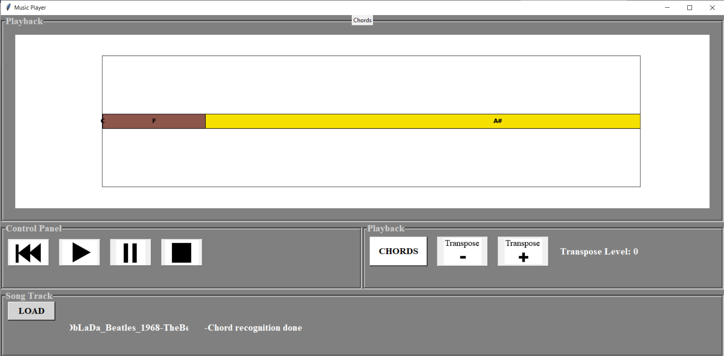
The Product

Slide 5
Thank you for your Attention and enjoy the demo
Our Team:
Christopher
Anna-Maria
Stefan
Notes:
Wählen Sie im Präsentationsmodus die Pfeile aus, um Links zu folgen.
9

